Slide 1
LegacyPlanning
NEO
Caring for the Ones You Love
The smart choice presentation template

Slide 2
What is Legacy Planning?
Legacy Planning is having your finances in order so your love ones receive your money and not the government and lawyers.
Creating a legacy involves having wills, medical directives, durable power’s of attorney and or trusts in place.
If you don’t have these in place, the courts will have to become involved and that means time and lawyer fees for your loved ones.

Slide 3
If you were to pass today, would your spouse and family be set financially?

Slide 4
The Problem:
There are approximately 77 million Baby Boomers who will pass in the coming decades leaving behind TRILLIONS OF DOLLARS…
Accidents, disease, and other issues can also affect younger people as well.
While some have plans in place,
MANY DO NOT!

Slide 5
Life and Health Insurance
70% of Americans are UNDER-INSURED!
Rule of thumb is you need at least 10 times your annual income in life insurance
Term insurance is cheap when you are young, but eventually “terms out”
Permanent life is meant to be their your entire life. It costs more upfront, but done properly it can:
Life-time of insurance coverage
Tax-Free Income in retirement
College Funding
Emergency funds
Opportunity Fund.
Some even offer Long Term Care Benefits

Slide 6
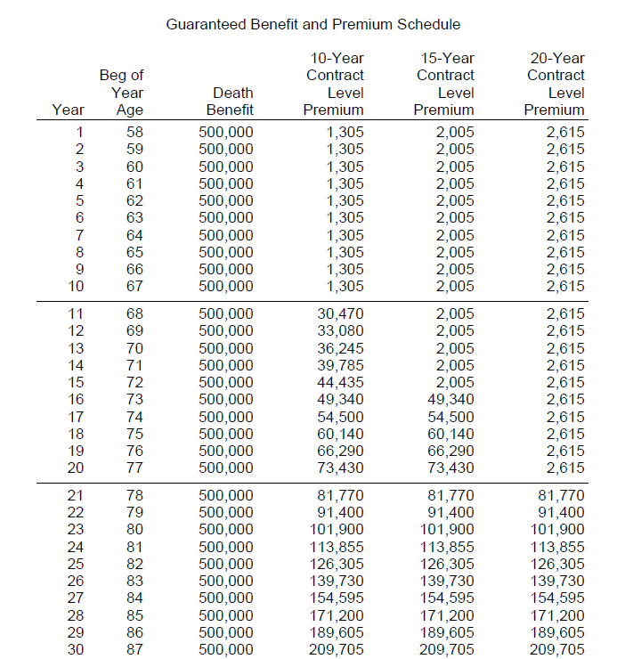
Life and Health Insurance
Do you have Life Insurance in place?
What is the death benefit?
If it is term, when does it term out?
If it is permanent; is it fully funded?
Have you considered:
Medicare?
Medicare Supplements?
Prescription Drug plans?
Do you have Long Term Care coverage?

Slide 7
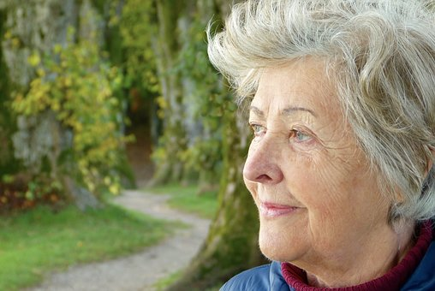
Legacy Plan Example
Mark dies at 71 years old, leaving his wife Mary and 2 adult children. Mark has $500,000 in his old 401(K) and wants the family to get the full amount.
He bought a $250,000 Index Universal Life insurance policy so that when he died, they could pay the taxes and have money left.

Slide 8
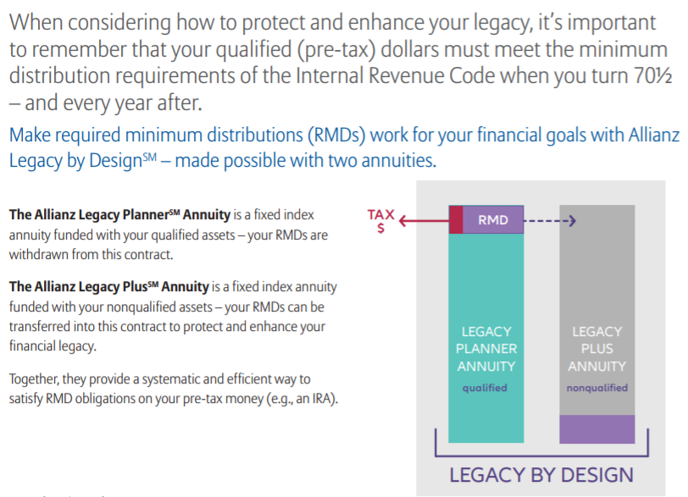

Slide 9
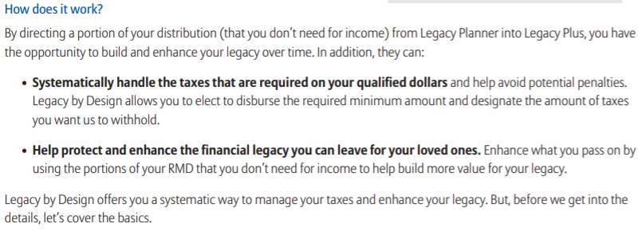

Slide 10
Estate Planning
Do you have Estate Plans and Medical Directives established?
A Will
An Advanced Medical Directive
A Durable Power of Attorney
A Trust

Slide 11
No matter your age, it’s important to make sure you have a plan to care for the ones you love.

Slide 12
LegacyPlanning
NEO
Caring for the Ones you Love
The smart choice presentation template

