Slide 1
MONEY
LIES
People
BELIEVE
about
Copyright 2020 TriQuest USA

Slide 2
Truth
about
Knowing the
How Money Works
Is an important step in securing the
Right Financial Plan
For YOU

Slide 3
1 | 0% Interest SAVES You Money
Opportunity cost – missing out on a benefit because you chose one option over another.
Need v. Want – an important distinction when making an informed decision

Slide 4
The Truth
0% could COST you money.
You should weigh the pros and cons

Slide 5
2 | You Should Pay off Your Mortgage BEFORE Building Wealth
Financial Leverage: it does not make sense (generally speaking) to pay off a 3% mortgage if you can earn a higher percentage on that extra money
If you invested $500 a month ($6K per year) x 7%...
15 years | $160,000+
20 years | $260,000+
30 years | $600,000+

Slide 6
The Truth
Paying the mortgage first could cost you valuable time and money.
Generally, you should build wealth FIRST.

Slide 7
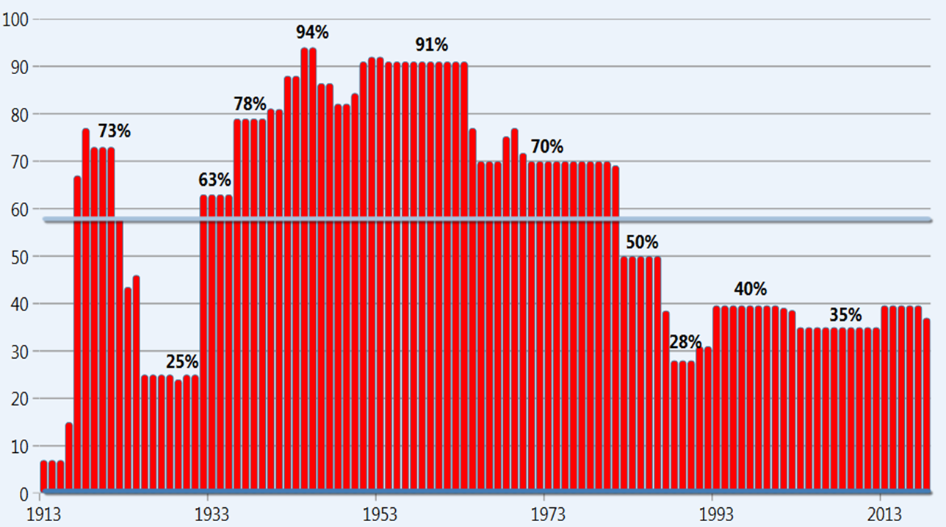
3 | You’ll Be in a LOWER Tax Bracket in Retirement

Slide 8
3 | You’ll Be in a LOWER Tax Bracket in Retirement
TAXES
?
Qualified Plan $
Perception
Retirement
Income
Reality

Slide 9
The Truth
Tax rates go up.
You should take advantage when they are “on sale”.

Slide 10
4 | The 4% RULE is a Safe and Acceptable Distribution Rate
Thought: If you withdraw 4% of your retirement accounts in the first year and adjust for inflation after that, you should have money to last for retirement.
Reality: It’s more like the 2% rule - “Say Goodbye to the 4% Rule” Wall Street Journal (Kelly Greene, March 2013)

Slide 11
The Truth
The 4% rule can fail.
You need a retirement income strategy that works.

Slide 12
Confidence
You can live with
and
Peace of Mind
When you have a
financial Plan based on
Sound Financial Advice

