Slide 1
Mission ONE Million
Navigating Life’s Challenges to Get
to a Successful Retirement
Fee-based financial planning and investment advisory services are offered by Rauch Advisory LLC, a Registered Investment Advisor in the state of Virginia. Insurance products and services are offered through Equity 1 Inc. Rauch Advisory LLC and Equity 1 Inc are non-affiliated companies.

Slide 2
Tax Risk
The common misconception is that you’ll be in a lower tax bracket in retirement when you are taking money from your qualified accounts (IRAs, TSPs, 401(k)s, etc.)
What if taxes go up?

Slide 3
Over a Century of Tax History

Slide 4
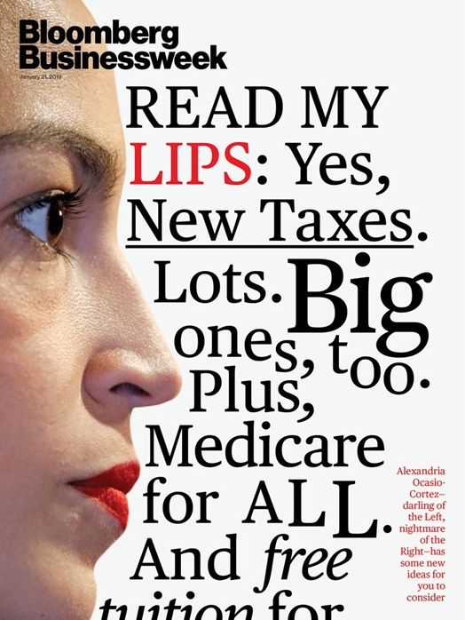
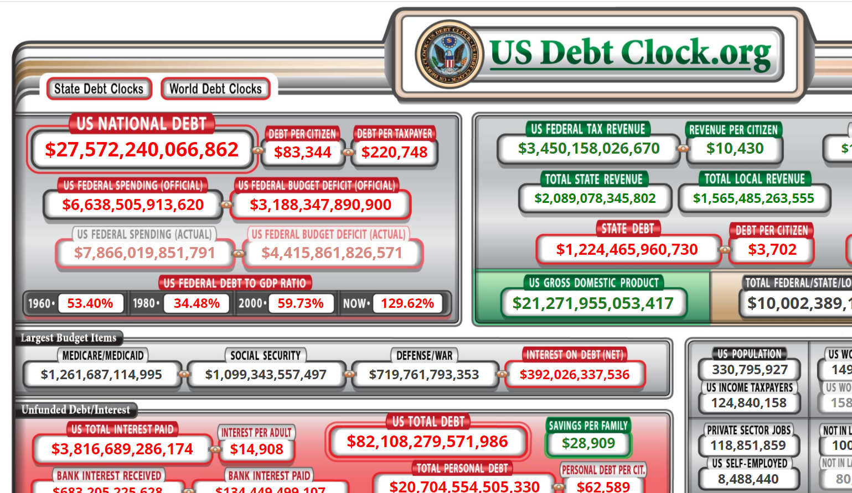
The Current Tax Conversation

Slide 5
Taxes
Gary and Martha (66 years old)
$50,000 (pension money)
$40,000 (Social Security)
$800,000 (IRAs)
Zero debt
Concerned about higher taxes and being forced to take money out in RMDs that they don’t currently need or anticipate needing in the future
Instead of waiting until 72 (in concert with the tax planner we introduced them to) we moved money from “RMD to Tax Free” retirement income with $400,000 of their money.

Slide 6
Write this down…
Am I following a plan that’s going to help me go from RMD to Tax Free?

