Slide 1
to
How to go from
RMD

Slide 2
What is an RMD?
A Required Minimum Distribution is the amount of money that must be withdrawn from Qualified Plans (401(k)s, IRAs, TSPs, etc.) once you reach age 70 ½
Notes:
Write this down – “Am I following a plan that’s going to help me go from RMD to Tax Free?”
Am I putting my trust that I’ll be able to enjoy a successful retirement in the hands of politicians?

Slide 3
Tax Risk
The common misconception is that you’ll be in a lower tax bracket in retirement when you are taking money from your qualified accounts (IRAs, TSPs, 401(k)s, etc.)
What if taxes go up?
Notes:
Often times, the first two obstacles, debt and market risk, are somewhat familiar concerns.
However, the threat of taxes in retirement could be one of the biggest obstacles people aren’t prepared for.
It is commonly assumed for those that have money in tax-deferred accounts that you will be in a lower tax-bracket in retirement.
What happens if tax rates change in the future, and you are required to take money (maybe more than you need) out of your accounts to satisfy the RMD amounts?

Slide 4
Over a Century of Tax History
Notes:
The graph illustrates the federal income tax history for over a century. Since 1913, the top marginal tax rates have fluctuated greatly as different Congresses changed the laws.

Slide 5
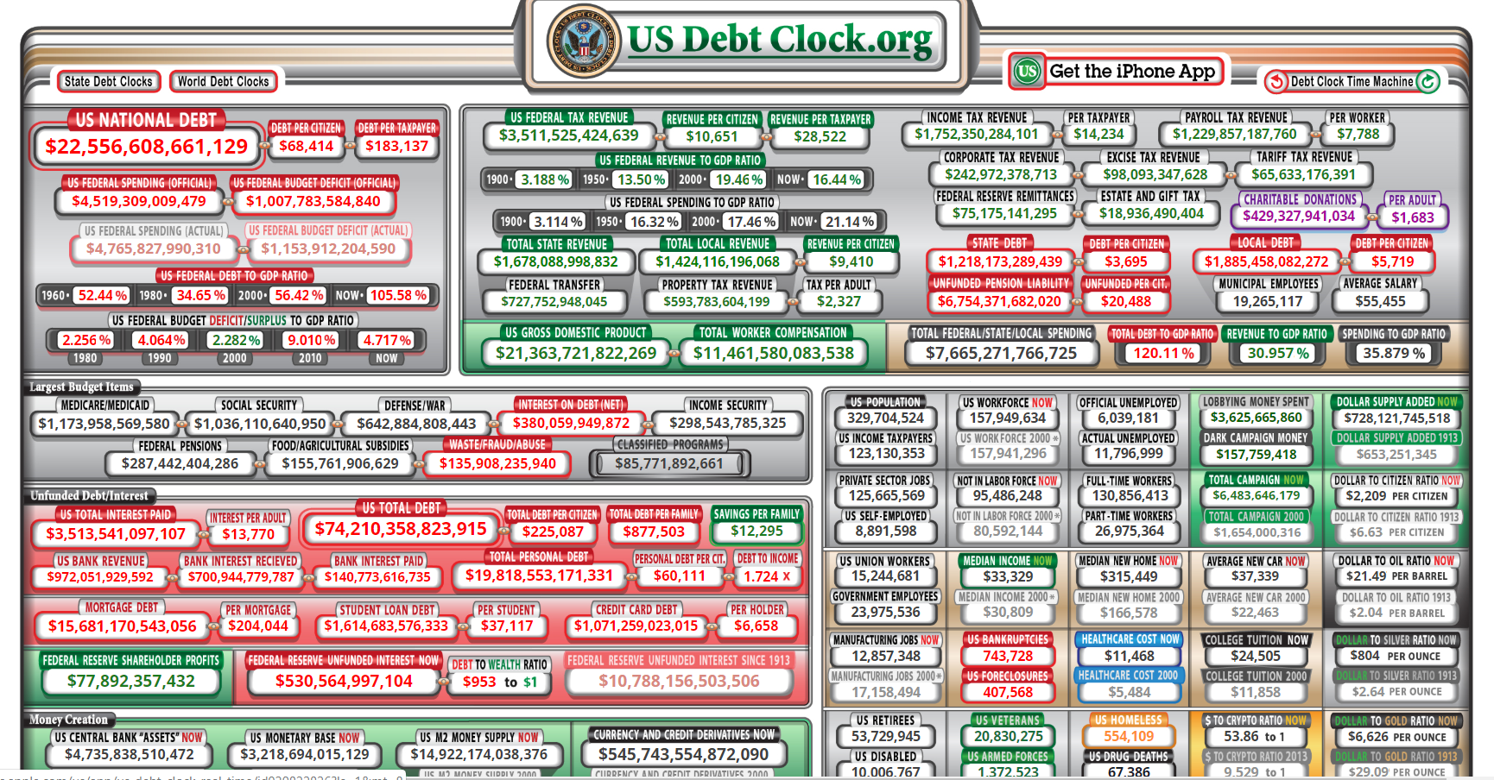
The Current Tax Conversation
Notes:
If you’ve read the headlines or watched any amount of the current political discussion, its hard to avoid the discussion of taxes being raised – and not just on the top brackets. Regardless of your political party affiliation or your thoughts on policy ideas like the Green New Deal or Medicare for All, College for All, etc., your financial plan must account for the possibility of higher taxes in the future to pay for these proposals.
The truth is, we don’t know what this Congress or future representatives will do. That’s why we must prepare and follow the right plan to ensure we can continue to live life we want throughout our retirement.

Slide 6
Tax Preparer v. Tax Planner
What’s the difference?
Tax Preparer – concerned about lowering your taxes for the current year
Tax Planner – concerned about BOTH your taxes today and those in the years to come
Notes:
Often times, the first two obstacles, debt and market risk, are somewhat familiar concerns.
However, the threat of taxes in retirement could be one of the biggest obstacles people aren’t prepared for.
It is commonly assumed for those that have money in tax-deferred accounts that you will be in a lower tax-bracket in retirement.
What happens if tax rates change in the future, and you are required to take money (maybe more than you need) out of your accounts to satisfy the RMD amounts?

Slide 7
Roth Conversions
When you convert to a ROTH IRA from a Traditional IRA, you generally pay income tax on the contribution
The taxable amount that is converted is added to your income taxes and your regular income rate is applied to your total income
Source: “Roth IRA Conversion Rules,” RothIRA.com
Notes:
Often times, the first two obstacles, debt and market risk, are somewhat familiar concerns.
However, the threat of taxes in retirement could be one of the biggest obstacles people aren’t prepared for.
It is commonly assumed for those that have money in tax-deferred accounts that you will be in a lower tax-bracket in retirement.
What happens if tax rates change in the future, and you are required to take money (maybe more than you need) out of your accounts to satisfy the RMD amounts?

Slide 8
Introducing...
Index
Universal
Life

Slide 9
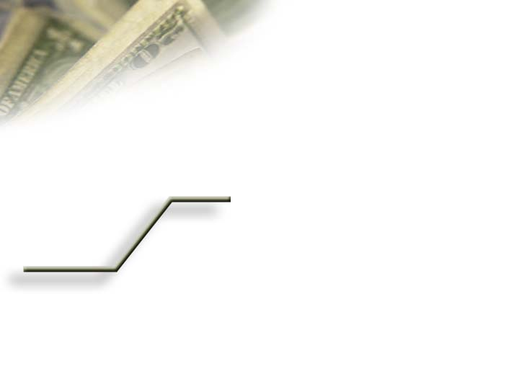
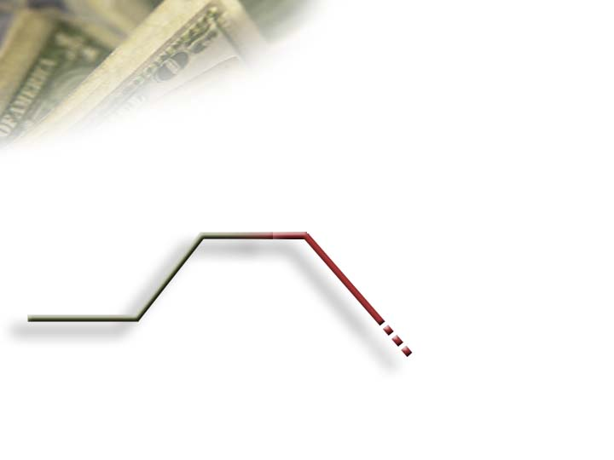
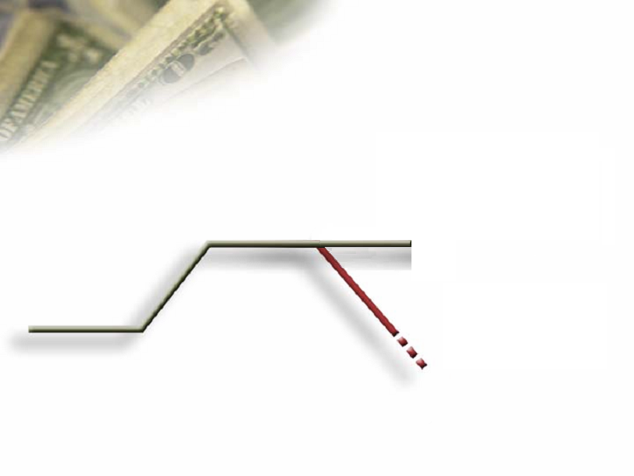
The Powerful Advantage of
Locking in Annual Gains
$115,500
5%
$110,000
$110,000
11%
10%
Gains
Become
Principal
$103,950
$100,000
-10%
5%
$99,000
That is a $11,705 difference because of the annual lock in and reset.
Notes:
Another feature the IUL has that separates it from all other financial products is the locking in of annual gains. It’s the second layer of protection for your money.
Here is how locking in of annual gains works.
If I had $100,000 of cash value in an IUL policy, and the market went up 10%, my cash would be credited $10,000.
That $10,000 would be added to my principal and I would have a new account value of $110,000—never to be given back. If the market went down 10%, in an equity vehicle, I would lose 10% of my $110,000 or end up with less then I started with $99,000.
By sustaining what was earned, even a modest 5% return the next year grows the cash very nicely to $115,500. But just losing 10% in one year created an 11% difference in the accumulate value of this account.
That’s a difference of $115,500 to $103,950.
Let me continue to share with you why avoiding the market loses are so beneficial in creating wealth.

Slide 10
How the Market Works
$103,950
$82,817
1,447
1,140
26.46%
No Cap
-37%
No
Floor
902
$65,489
3/2008
3/2009
3/2010
Notes:
In our previous example our $100,000 experienced a 10% gain, a 10% loss, and a 5% gain giving us an ended balance of $103,950.
When the market tanked in 2009 by 37%, the $103,950 diminished to $65,488.
By 2010 the market ran up 26.46% but our account value isn't anywhere near back to where we started.
This is how the market works.

Slide 11
How Index Reset Works
$115,500
$130,515
1,447
1,140
26.46%
13%
Cap
0%
Floor
902
$115,500
3/2008
3/2009
3/2010
Notes:
If your money had been in an IUL Policy in 2009, your cash value would have been protected because of the zero floor feature.
There is another strong feature of an IUL policy that protects your gains and helps your cash continue to grow. It’s called the reset feature. It resets the equity index value on your IUL's anniversary.
In this example the S&P Index dropped from 1,447 to 902. The year after it dropped, the IUL policy would start with a new Index Value of 902, not 1,447. It would count any gain the next year from this new reset value.
In this case the market increased by 26.46%. The IUL is capped at 13%. But the cash value is earning 13% on $115,500 versus 26.46% on the $65,488 we were left with in the open market.
It is important to point out the S&P index value hasn't even gotten back to the 2008 starting value of 1,447, yet the cash value in the IUL policy has grown by an additional $15,000 .
There is no other product I know of that can protect and grow your money like this?

Slide 12
Year | Historical Return of S&P 500 | $100,000 | Index Universal Life Policy | $100,000
2000 | -9.10 | $90,900 | 0% | $100,000
2001 | -11.89 | $80,092 | 0% | $100,000
2002 | -22.10 | $62,392 | 0% | $100,000
2003 | 28.69 | $80,292, | 13.00% | $113,000
2004 | 10.88 | $89,028 | 9.00% | $123,170
2005 | 4.91 | $93,399 | 3.00% | $126,865
2006 | 15.79 | $108,147 | 13.00% | $143,358
2007 | 5.49 | $114,084 | 3.53% | $148,418
2008 | -37.00 | $71,873 | 0% | $148,418
2009 | 26.46 | $90,890 | 13.00% | $167,712
2010 | 15.06 | $104,578 | 12.78% | $189,515
2011 | 2.11 | $106,785 | 0% | $189,515
2012 | 16.00 | $123,871 | 13.00% | $213,735
2013 | 32.39 | $163,992 | 13.00% | $241,521
2014 | 13.69 | $186,443 | 11.39% | $269,030
2015 | 1.38 | $189,016 | 0% | $269,030
2016 | 11.96 | $211,622 | 9.54% | $294,695
2017 | 21.83 | $257,819 | 13.00% | $333,006
Acct Balance |  | $257,819 |  | $333,006
Avg ROR | 5.41% |  | 6.91%
The S&P Index values include the annual dividends or total returns – The IUL column uses only the S&P annual price values. This is why there are differences in the crediting values in years 5, 6, 8,11,12, and 15 on the IUL column.
Notes:
Let's compare an IUL contract with a cap of 13 percent and a floor of zero to an equity account over the last 15 years to see how beneficial these features are.
We can see how the floor feature works right away from 2000 to 2002 when the market went down 3 years in a row. On the $100,000 initial deposit, the equity account lost money. The IUL policy stayed at $100,000—it didn’t make any money but more importantly, it didn’t lose any either.
In year 2003 when the market rebounded, the equity account credited 28.69 percentage. The index went above the 13% cap that year. The equity account gained 26.38%, but because it had lost so much money in 2000 to 2002, the account hasn’t made back all its losses.
The IUL policy, however, because it didn’t lose any money in the down markets, enjoyed a 13% gain. The difference is in the cash value in year 4 on these two accounts: $80,292 in the equity account, versus $113,000 in the IUL cash value.
The floor feature allowed the limited cap feature to still take advantage of the majority of the market upside potential without participating in the downside. Over the past 15 years using a 0% floor and a 13% cap the IUL faired very well against the open market gains and losses, in this example $85,000 better off.

Slide 13
Taxes
Gary and Martha (66 years old)
$50,000 (pension money)
$40,000 (Social Security)
$800,000 (IRAs)
Zero debt
Concerned about higher taxes and being forced to take money out in RMDs that they don’t currently need or anticipate needing in the future
Instead of waiting until 70 ½ (in concert with the tax planner we introduced them to) we moved money from “RMD to Tax Free” retirement income with $400,000 of their money.
Notes:
[Client Example – highlights how we helped reduce the tax risk in his tax-deferred accounts by going from “RMD to Tax Free”]

Slide 14
People with pensions or significant amounts of money in tax-deferred vehicles can benefit from this from the “RMD to Tax Free” move
Notes:
Write this down – “Am I following a plan that’s going to help me go from RMD to Tax Free?”
Am I putting my trust that I’ll be able to enjoy a successful retirement in the hands of politicians?

Slide 15
Takeaway Question:
Am I following a plan that’s going to help me go from RMD to Tax Free?
Notes:
Write this down – “Am I following a plan that’s going to help me go from RMD to Tax Free?”
Am I putting my trust that I’ll be able to enjoy a successful retirement in the hands of politicians?

