Slide 1
Tax-Free Retirement
Tax-deferred $≠$ Tax-free

Slide 2
Tax Risk
COPYRIGHT 2018 - TRIQUEST INSURANCE AGENCY, LLC
Notes:
How many of you agree that our country’s debt is huge?
Our country’s debt problem can be illustrated as a set of circles.
Inside the inner circle is of course the national debt. Right now that stands at about $18 trillion.
The debt for all the states in the US equals about $1.3 trillion. This is why state employee pensions are
running out of money.
Next comes local municipalities. They owe about $1.8 trillion, and many of them are teetering on the
edge of bankruptcy.
Now what balloons all this out to something that is over-the-top scary is the US’s total unfunded
liabilities like Medicare and Social Security. That stands at $224 trillion.
Add to that all our leveraged debt from the derivatives market (think oil futures and stuff like that)
you’re looking at $235 trillion more.
American households hold about $16.1 trillion in personal debt.
Add that all up, and the US debt is close to five hundred trillion dollars.
That is an unfathomable amount of money.

Slide 3
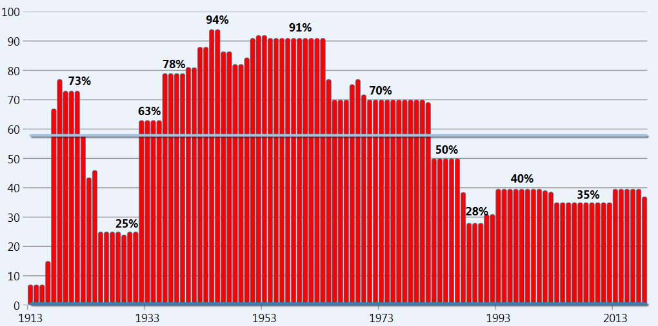
From 1913 until 2018 the Average Income Tax bracket has been
57.69%
Notes:
From 1913 to 2014 the average tax bracket is 58.43%. Notice the highest tax bracket from the mid 1940s to the mid 1960s. Yes, That’s right. 90%!
If the average income tax bracket is in the 27% range today, and we have all this government debt, what do you believe will happen to the tax rates levied on the qualified plans like 401(k)’s and IRA’s when distributed during retirement in the future?
If you’re thinking the government knows our average tax bracket it low—and that debt needs to be paid somehow, you’re right. It’s all over the news how the government has their eye on your retirement savings in qualified plans like 401(k)s and IRAs. And remember, at age 70½ it is mandatory you take your required minimum distributions. If you don’t, you will pay a 50% penalty on the distribution.
The U.S. Government will get their share one way or another.
According to Nancy Pelosi, the government should confiscate the 401(k)s to reduce the US debt, and pay the owners of the account a fixed static income stream for the confiscated account.

Slide 4
ROTH IT
INSURE IT
Index Universal Life
ROTH IRA Conversion

Slide 5
Roth IRA Conversions
When you convert to a Roth IRA from a Traditional IRA, you generally pay income tax on the contribution.
The taxable amount that is converted is added to your income taxes and your regular income rate is applied to your total income.
Source: “Roth IRA Conversion Rules,” RothIRA.com
COPYRIGHT 2018 - TRIQUEST INSURANCE AGENCY, LLC

Slide 6
Index Universal Life Policy
Ceiling
Goals
13.00 %
Have the potential for
market gain without risk of
principal
“Cap”
Use of an index like Standard
and Poor’s 500 or the DOW
Guarantee of principal
0%
Floor
COPYRIGHT 2018 - TRIQUEST INSURANCE AGENCY, LLC
Notes:
Index Universal Life Policies are the perfect product if you are looking for a place to grow your money safely, and provide a steady predictable tax-free retirement income.
Let me explain how and why!
The Index Universal Life was created to allow you the potential to earn market gains, without exposing your principal to market risk.
It does this by using an Equity Index like the S&P 500 to track and credit market gains. However your money is not in the market; the interest you earn is based on the Index performance. This allows the insurance company to put in place some powerful safety features.
One of those features is an Index Cap and an Index Floor, these are terms you probably never heard of before. Here’s how it works.
The IUL contract credits the index performance annually to your policies cash value. The floor means if the S&P Index goes NEGATIVE from your policy anniversary date to the end of the year, your annual earnings from the index will be zero, you do not participate in the index loss. This protects your cash value when the market drops below zero. It’s your safety net, and it's contractual feature of your IUL policy. Because the floor is permanently set at zero percent, you can never lose money.
When the S&P index has a positive gain, The Index cap percentage is the highest percentage of gains your cash value would be credited for that year. On this illustration the cap is set to 13%. The insurance company sets the cap. I have seen these caps as low as 8 percent and as high as 17 percent. Each insurance company is different, and the caps can change annually.
This is how the Cap and Floor feature works.

Slide 7
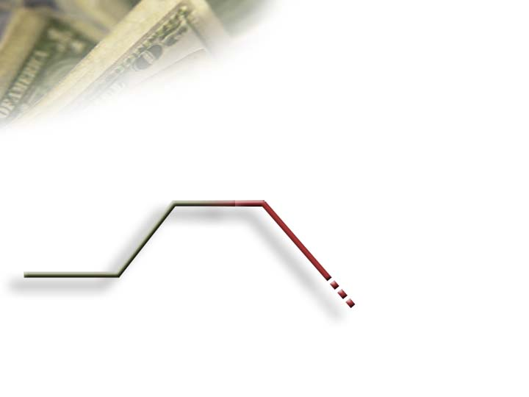
The Powerful Advantage of
Locking in Annual Gains
$115,500
5%
$110,000
$110,000
11%
10%
Gains
Become
Principal
$103,950
$100,000
-10%
5%
$99,000
That is a $11,705 difference because of the annual lock in and reset.
Notes:
Another feature the IUL has that separates it from all other financial products is the locking in of annual gains. It’s the second layer of protection for your money.
Here is how locking in of annual gains works.
If I had $100,000 of cash value in an IUL policy, and the market went up 10%, my cash would be credited $10,000.
That $10,000 would be added to my principal and I would have a new account value of $110,000—never to be given back. If the market went down 10%, in an equity vehicle, I would lose 10% of my $110,000 or end up with less then I started with $99,000.
By sustaining what was earned, even a modest 5% return the next year grows the cash very nicely to $115,500. But just losing 10% in one year created an 11% difference in the accumulate value of this account.
That’s a difference of $115,500 to $103,950.
Let me continue to share with you why avoiding the market loses are so beneficial in creating wealth.

Slide 8
How the Market Works
$103,950
$82,817
1,447
1,140
26.46%
No Cap
-37%
No
Floor
902
$65,489
3/2008
3/2009
3/2010
Fee-based financial planning and investment advisory services are offered by Rauch Advisory LLC, a Registered Investment Advisor in the state of Virginia. Insurance products and services are offered through Equity 1 Inc. Rauch Advisory LLC and Equity 1 Inc are non-affiliated companies.
Notes:
In our previous example our $100,000 experienced a 10% gain, a 10% loss, and a 5% gain giving us an ended balance of $103,950.
When the market tanked in 2009 by 37%, the $103,950 diminished to $65,488.
By 2010 the market ran up 26.46% but our account value isn't anywhere near back to where we started.
This is how the market works.

Slide 9
How Index Reset Works
$115,500
$130,515
1,447
1,140
26.46%
13%
Cap
0%
Floor
902
$115,500
3/2008
3/2009
3/2010
Notes:
If your money had been in an IUL Policy in 2009, your cash value would have been protected because of the zero floor feature.
There is another strong feature of an IUL policy that protects your gains and helps your cash continue to grow. It’s called the reset feature. It resets the equity index value on your IUL's anniversary.
In this example the S&P Index dropped from 1,447 to 902. The year after it dropped, the IUL policy would start with a new Index Value of 902, not 1,447. It would count any gain the next year from this new reset value.
In this case the market increased by 26.46%. The IUL is capped at 13%. But the cash value is earning 13% on $115,500 versus 26.46% on the $65,488 we were left with in the open market.
It is important to point out the S&P index value hasn't even gotten back to the 2008 starting value of 1,447, yet the cash value in the IUL policy has grown by an additional $15,000 .
There is no other product I know of that can protect and grow your money like this?

Slide 10
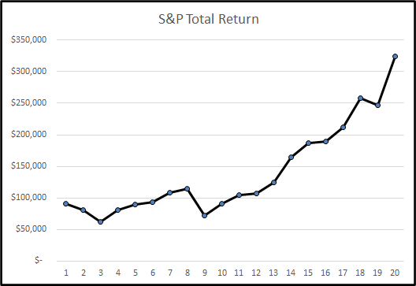
Year | Historical Return of S&P 500 | $100,000
2001 | -11.89 | $88,110
2002 | -22.10 | $68,638
2003 | 28.69 | $88,330
2004 | 10.88 | $97,940
2005 | 4.91 | $102,749
2006 | 15.79 | $118,973
2007 | 5.49 | $125,505
2008 | -37.00 | $79,068
2009 | 26.46 | $99,989
2010 | 15.06 | $115,047
2011 | 2.11 | $117,474
2012 | 16.00 | $136,270
2013 | 32.39 | $180,408
2014 | 13.69 | $205,106
2015 | 1.38 | $207,936
2016 | 11.96 | $232,805
2017 | 21.83 | $283,626
2018 | -4.38 | $271,203
2019 | 31.49 | $356,605
2020 | 18.40 | $422,220
Avg ROR | 7.47% | $422,220
Market Risk
Fee-based financial planning and investment advisory services are offered by Rauch Advisory LLC, a Registered Investment Advisor in the state of Virginia. Insurance products and services are offered through Equity 1 Inc. Rauch Advisory LLC and Equity 1 Inc are non-affiliated companies.
COPYRIGHT 2018 - TRIQUEST INSURANCE AGENCY, LLC
Notes:
The number one risk is market risk. The last 18 years from 2000 to 2017 we have experienced 4 major market corrections, including the great recession of 08’. As I said in my introduction, if you lived through any of those, you know how painful a market correction can be. It’s not just a “paper loss.” When you lose money in the stock market, you’re losing your hard earned cash.
Here’s what has happened over the last 18 years. This chart shows the annual rates of return, including dividends, in the S&P 500 index, one of the most widely used measurements of market performance in the world.
Look at 2000 to 2005 on the chart. Your account balance on your initial $100,000 investment is still less than what you started with.
In ’06 and ’07, you’re now above the $100,000 you started with, but in ’08 you lose almost 40%. Your savings is decimated.
You’ll see at the bottom, the total return of 5.40% over the last 18 years. This doesn’t include taxes on the gains or any fees to manage the account. If we assumed taxes and fees this would diminish the return by 2%, and our gains would barely stay up with today's inflation.
The chart to right gives a visual of the roller coaster ride you had to experience to receive such a small return.
This is assuming you had the gumption to stay on the ride until today.
Why does this matter to you? Well, the majority of people are influenced to do what everyone else does, follow the Status Quo. If there’s a 401(k) available at work, everyone else is using it, so you do too.
You choose the conservative, moderate, or aggressive fund allocation, depending on what your risk tolerance are or what your co-workers are doing. Some people don't even look at their monthly statements. They have this attitude that it must be OK, no one at work is complaining. If a negative comment is made, it’s dismissed as casual conversation. But if you have your retirement savings in a 401(k) or in an IRA, your money is in the market. It’s exposed to risk.
If this sounds familiar, type Yes it does! In the comment box right now…

Slide 11
Year | Historical Return of S&P 500 | $100,000 | Index Universal Life Policy | $100,000
2001 | -11.89 | $88,110 | 0% | $100,000
2002 | -22.10 | $68,638 | 0% | $100,000
2003 | 28.69 | $88,330 | 13.00% | $113,000
2004 | 10.88 | $97,940 | 9.00% | $123,170
2005 | 4.91 | $102,749 | 3.00% | $126,865
2006 | 15.79 | $118,973 | 13.00% | $143,358
2007 | 5.49 | $125,505 | 3.53% | $148,418
2008 | -37.00 | $79,068 | 0% | $148,418
2009 | 26.46 | $99,989 | 13.00% | $167,712
2010 | 15.06 | $115,047 | 12.78% | $189,515
2011 | 2.11 | $117,474 | 0% | $189,515
2012 | 16.00 | $136,270 | 13.00% | $213,735
2013 | 32.39 | $180,408 | 13.00% | $241,521
2014 | 13.69 | $205,106 | 11.39% | $269,030
2015 | 1.38 | $207,936 | 0% | $269,030
2016 | 11.96 | $232,805 | 9.54% | $294,695
2017 | 21.83 | $283,626 | 13.00% | $333,006
2018 | -4.38 | $271,203 | 0% | $333,006
2019 | 31.49 | $356,605 | 13.00% | $380,027
2020 | 18.40 | $422,220 | 13.00% | $429,428
Acct Balance |  | $422,220 |  | $429,428
Act ROR | 7.47% |  | 7.56%
The S&P Index values include the annual dividends or total returns – The IUL column uses only the S&P annual price values. This is why there are differences in the crediting values in years 5, 6, 8,11,12, and 15 on the IUL column.
Notes:
Let's compare an IUL contract with a cap of 13 percent and a floor of zero to an equity account over the last 15 years to see how beneficial these features are.
We can see how the floor feature works right away from 2000 to 2002 when the market went down 3 years in a row. On the $100,000 initial deposit, the equity account lost money. The IUL policy stayed at $100,000—it didn’t make any money but more importantly, it didn’t lose any either.
In year 2003 when the market rebounded, the equity account credited 28.69 percentage. The index went above the 13% cap that year. The equity account gained 26.38%, but because it had lost so much money in 2000 to 2002, the account hasn’t made back all its losses.
The IUL policy, however, because it didn’t lose any money in the down markets, enjoyed a 13% gain. The difference is in the cash value in year 4 on these two accounts: $80,292 in the equity account, versus $113,000 in the IUL cash value.
The floor feature allowed the limited cap feature to still take advantage of the majority of the market upside potential without participating in the downside. Over the past 15 years using a 0% floor and a 13% cap the IUL faired very well against the open market gains and losses, in this example $85,000 better off.

Slide 12
What are these?
7702
72(e)
These are the IRS Tax codes that control
the Product Development of Life Insurance
COPYRIGHT 2018 - TRIQUEST INSURANCE AGENCY, LLC
Notes:
Let me introduce you to another set of numbers.
They are also IRS tax codes. They regulate how the Family Financial Miracle works, and this is one instance where you can make the IRS code work for you.
These codes are not as commonly known. You have to dig for this information.
My mentor, Merle Gilley, spent three years studying them and uncovering all the details—and he taught me all that he found.
What are they? These are the IRS Tax Codes that control the product development and guidelines to create permanent life insurance.
But this is what many don’t know. These tax codes are exactly what make what I’m about to show you adhere to all three family financial principals.
For when you use them correctly, you can optimize the cash value in a life insurance contract and truly enjoy the living benefits few know about with this product
In other words, you have lost control of your future.
Think about it.
With government regulated qualified plan, you lose two of the three family financial principals, Protection and Income.
No one should be OK with that.

Slide 13
Introducing...
Index
Universal
Life
COPYRIGHT 2018 - TRIQUEST INSURANCE AGENCY, LLC
Notes:
When I say life insurance, you think “really?”
You’re skeptical, I know. However, the permanent life insurance isn’t the kind your granddad had—where he put in money but didn’t have any access to it while he was alive.
This is a very powerful form of life insurance called Index Universal Life.
Index Universal Life Insurance enables you to grow and protect your money while securing a predictable retirement income. If it is funded properly and distributed smartly, you never have to worry about outliving your retirement. You have access to your cash with no early withdrawal penalties. And here’s the best part—that money can be available to you tax-free. Do you know anything else that can do that?
Index Universal Life was specifically created by life insurance companies to capitalize on the tax advantages the IRS Code 7702 and 72(e) provide, the codes I just told you about.
Let me explain how this amazing product works, and how you can use it to create your own Family Financial Miracle.

Slide 14
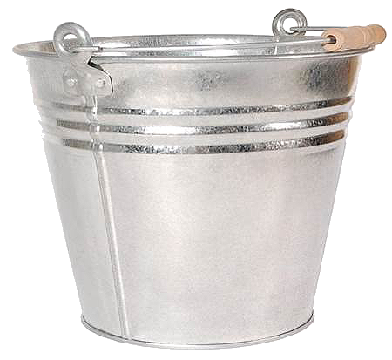
80%
20%
0%
Tax
Deferred
Taxable
Tax
Free
Money is typically held in three buckets
COPYRIGHT 2018 - TRIQUEST INSURANCE AGENCY, LLC

Slide 15
15%
5%
80%
Tax
Deferred
Taxable
Tax
Free
A Better Solution Today!
COPYRIGHT 2018 - TRIQUEST INSURANCE AGENCY, LLC

Slide 16
How will you handle your
tax risk problem?

