Slide 1
Prospecting

Slide 2
Mastering Prospecting
90% of Agent surveyed said they experience Anxiety when prospecting.
What causes Anxiety?
Fear of Rejection - Understand “Why” you are doing this
Lack of Preparation – You haven’t studied or practiced
It never goes away; it just becomes tolerable
What is the worst thing that can Happen?
Block out time and set daily and weekly goals
Flip the goal, how many “No’s” can I get today?
To be successful in this business you must Master prospecting

Slide 3
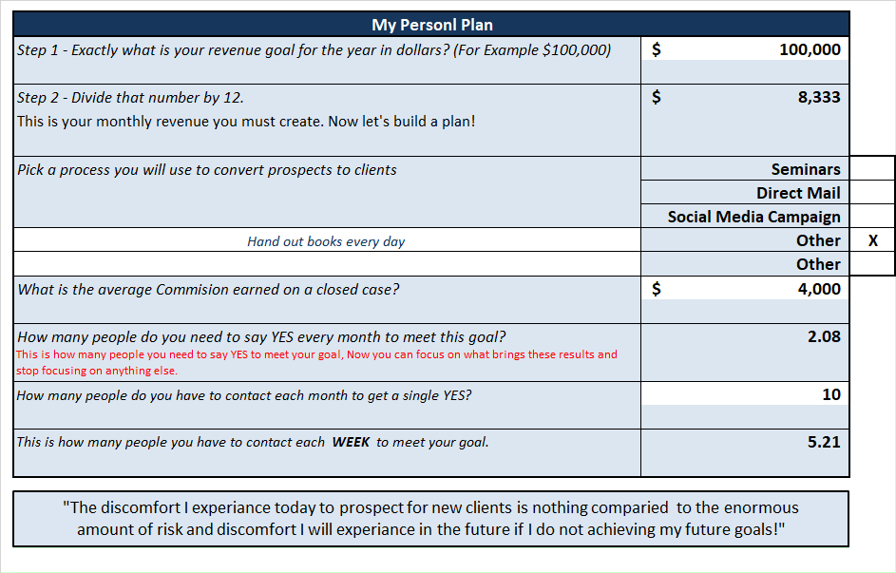
Prospecting Goals

Slide 4
Converting Books to Money

Slide 5
The Book Prospecting System
It is physical (tangible)
It can be handed out
It can be mailed
It can be left behind
It can be sold
It can be used as a giveaway
MyFamilyFinancialMiracle.com/Video
9 locations in the book

Slide 6
Prospecting with the Book
Hand deliver to prospects
Direct mail to warm market
Direct mail to existing clients
Direct mail to third party mailing list
Shock and Awe box mailed to Business Owners
Write an article for social media and offer a free book

Slide 7
Who Are Your Potential Clients?
Anyone who earns a living…
Has a Mortgage
Funding a Retirement Acct
Has money in the Market
Has a family
Children College needs
Has grand children
Wants to pass on Money
Almost everyone!

Slide 8
Let’s Start Here
Hand delivering to prospects
“The sole purpose of prospecting is to
make an appointment.”

Slide 9
Hand Delivering to Prospects
It is a three-part process to hand out a book
Create a sense of urgency or a need
Fulfill the need
Set expectations

Slide 10
Creating a Sense of Urgency
Bill, you remember in 2000, and in 2008 when the
market crashed? The span between those corrections were
about 8 years. We’re now in 2021, and we’ve had a pretty good
run for the last 11 years. We’ve been hearing for a while
from the financial analyst we are headed for another big
correction. Does that bother you at all?
Yes, it does!

Slide 11
Creating a Sense of Urgency
Jim, I was listening to news, and I heard our national debt has
exceeded 85 trillion dollars, and it was stated that 75% of all
the money received from our taxes are being used to pay for
Social Security and Medicare. This leaves very little funds
available for our Military, or to afford to run our government.
Does this bother you?
Yes it does!

Slide 12
Fulfill a need and Set Expectations
I recently read a book that a good friend of mine authored, that
has changed the direction I’ve decided to take my business.
He addresses some of the issues we are talking about. His book
has 135 pages, but I’ve highlighted 20 of some of the most
powerful pages you should read.
If I give you my book with the highlights in it, will you read it
over the next couple of days? “Yes, I would love to”
Great, today is Tuesday, I will call you Thursday to see what you
think of the book, is that OK?
Get phone number and email address

Slide 13
Email the Prospect
MyFamilyFinancialMiracle.com/Video
Training Videos
Math Doesn’t Equal Money Pg-22
Poor Sequence of Returns Pg-23
$1 Trillion Dollars Pg-31
Caps & Floors Pg-67
10 Min. Lesson on Life Ins. Pg-73
Policy Loan / Collateralization Pg-78
IUL Policy Statement Pg-86
Never run out of Money Pg-94
Cost of Insurance Pg-106

Slide 14
Ask Open Ended Questions
What was your favorite chapter?
What resonated with you the most?
What keeps you up at night?
What had the biggest impact on you?
What do you see yourself wanting to fix first?
Which video did you find most interesting?
What topic can I provide more information on?

Slide 15
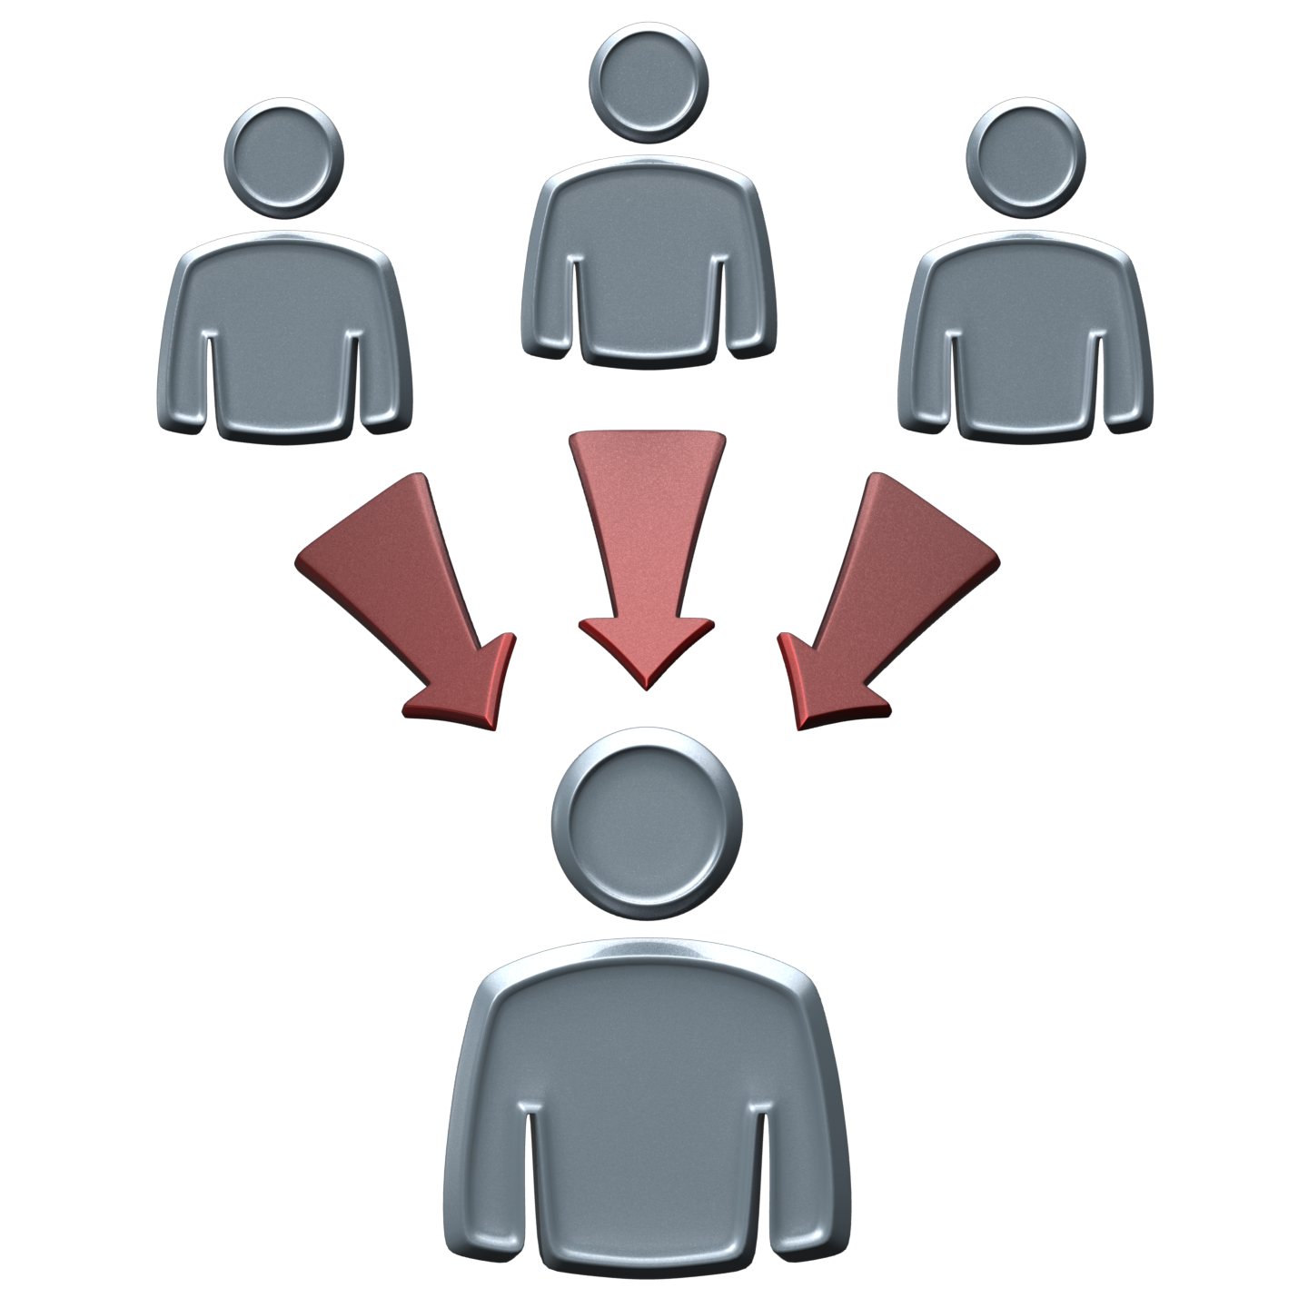
Let the Book Do the Heavy Lifting
Turns Prospects into Sales
Weed out People that wastes time
Starts or continues a conversation
Gets clients to divulge information
Introduces clients to see what could be

Slide 16
Set the Appointment
Relationship is triggered
Go Through ECU process
Education, Comfort level, Understanding

Slide 17
Get the book into
the hands of your prospects!!!!
Meet or Exceed your
Prospecting Goals

