Slide 1
Retirement R admap
Pointing You on the Right Path to Retirement

Slide 2
Retirement isn’t all about money… But money is a tool that helps us live and give the way we want in retirement.

Slide 3
What does your
Retirement Destination
look like?

Slide 4
You need a plan for how to get there.

Slide 5
Steps to take
5
Maximize Retirement Income
Minimize Your Taxes
Protect Your Investment
Secure Long Term Care
Safeguard Your Legacy

Slide 6
Don’t Run Out of Gas…

Slide 7
Maximize Retirement Income
1 |
Paychecks
Playchecks
The Amounted Needed to Cover Your Necessary Living Expenses:
Housing
Food
Transportation
Clothing
( Compensating for inflation )
The Amounted Needed to Cover Your Lifestyle Desires:
Travel
Eating out
Golfing
Spa
Giving

Slide 8
“Securing a base level of lifetime income should be every retiree’s priority – at least if they want to live happily ever after…”
TIME Magazine, “Lifetime Income Stream Key to Retirement Happiness,” July 2012

Slide 9
Maximize Retirement Income
1 |
3 Types of Guaranteed Income:
Social
Security
Income
Annuity
Pension

Slide 10
Maximize Retirement Income
1 |
Social Security:
Largest part of most people’s retirement plan.
Benefits can be claimed (i) based on your work history, (ii) through a current or divorced spouse, or (iii) by disability.

Slide 11
Maximize Retirement Income
1 |
When should you claim your Social Security Benefits?
70
Maximum Benefit Age
Your Full Retirement Age depends on the year you were born.
If you were born in 1960 or after, your Full Retirement Age is 67.
}
| | | | | | | | |
66
Full Retirement Age?
62
Early Retirement Age

Slide 12
Maximize Retirement Income
1 |
What percentage of your Social Security Benefits could be taxed?
 | Combined Income
Taxable Portion of Benefits | Single Filer | Joint Filer
50% | $25,000 to $34,000 | $32,000 to $44,000
85% | Over $34,000 | Over $44,000

Slide 13
Maximize Retirement Income
1 |
Pensions:
Regular payments from a retirement fund an employer contributed to during the employee’s time there.
Not as common (or as generous) today as they once were.

Slide 14
Maximize Retirement Income
1 |
Income Annuities:
Can give a guaranteed lifetime income stream (depending on the product)
Transfer the risk from you to the insurance company
Pension substitute
Investing involves risk, including the potential loss of principal. No investment strategy can guarantee a profit or protect against loss in periods of declining values. Any comments regarding protection benefits or steady and reliable income streams refer only to fixed insurance and annuity products. They do not refer, in any way, to securities or investment advisory products. Insurance and annuity product guarantees are subject to the claims-paying ability of the issuing company

Slide 15
Not all annuities are created equal

Slide 16
Retirement Checkpoint
To figure out your Guaranteed Income Gap, fill in the following information:
$ ______________ (Income needs per month)
- $ ______________ (Guaranteed income per month)
$ ______________ (Guaranteed Income Gap)

Slide 17
Minimize Your Taxes
2 |
Qualified Plan – an individual or employer-sponsored plan that allows you to postpone paying the taxes until you take the money out of the account.
401(k)
403(b)
TSP
457
SEP IRA
Simple IRA

Slide 18
Minimize Your Taxes
2 |
Most people act like all the money in their Qualified Plan is theirs…
In reality, the government will take a share in taxes when money is taken out.
Your Money
Your Money
Taxes?

Slide 19
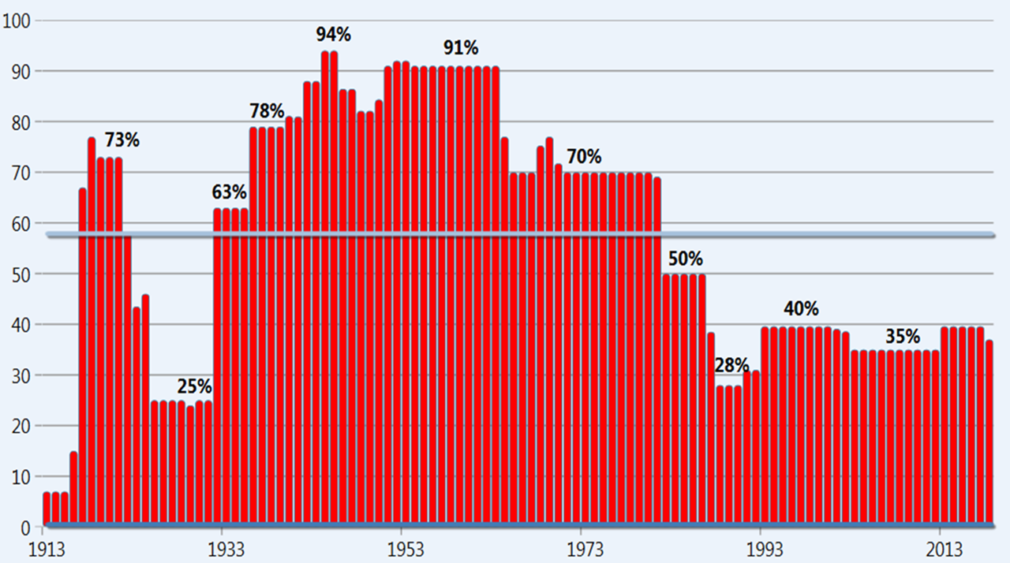
Minimize Your Taxes
2 |
What tax bracket will you be in when you retire?

Slide 20
In the future, do you think taxes will: - Go up, - Go down, or - Remain the same?

Slide 21
Retirement Checkpoint
What percentage of your total portfolio is in “tax me later” vs. “tax free retirement” accounts:
_______%
_______%
Tax Free Retirement
Tax Me Later

Slide 22
Protect Your Investments
3 |
Hypothetical Example
Age: 60-years-old
Assets: $1,000,000
Annual withdrawals:
$50,000 + 3% adjustments
Terry
Jerry
This hypothetical example is for illustrative purposes only. The character in this example/illustration is fictional. Your actual experience will vary. This is not intended to project the performance of any specific investment or index. It is not possible to invest directly in an index. If this were an actual product, the returns may be reduced by certain fees and expenses. Withdrawals are subject to ordinary income tax and, if taken prior to age 59½, a 10% federal tax penalty.

Slide 23
“Market losses in the first 5 years of retirement could shorten your portfolio by 15 years”
Robert Pagliarini, “The Stunning Problem with the 4% Retirement Income Rule in One Chart,” Forbes, January 2020

Slide 24
Protect Your Investments
3 |
Year 1: 27%
Year 2: 9%
Year 3: 7%
Year 4: -15%
Average: 7%
Year 1: -15%
Year 2: 7%
Year 3: 9%
Year 4: 27%
Average: 7%
Terry
Jerry
The average is the same, but the amount is not…

Slide 25
Protect Your Investments
3 |
A zero balance would occur in…
37 Years
A zero balance would occur in…
24 Years
Terry
Jerry
Both Timing and Returns impact retirement income!

Slide 26
Are you risking more than you should based on your age?

Slide 27
Retirement Checkpoint
Your age should match the percentage of your assets in conservative accounts.
100% – (Your Age)%=________
Conservative: ___________
More aggressive: __________

Slide 28
Secure Long Term Care
4 |
Go-Go Years
Slow-Go Years
No-Go Years
Tom Hegna, “Don’t Worry, Retire Happy: Seven Steps to Retirement Security.”

Slide 29
“6 out of 10 people 65 and older who file bankruptcy do so because they can’t afford to pay their enormous medical bills.”
Lucy Lazarony, “Why Are So Many People over 55 Going Bankrupt,”
MarketWatch, November 2019

Slide 30
Retirement Checkpoint
Do you have plans for the following in place:
Medicare?
Medicare Supplements (to cover any gaps)
Long Term Care?
Hybrid Long Term Care?

Slide 31
Safeguard Your Legacy
5 |
Your legacy should…
Match
Your
Values
Be
Known
Be
Entrusted
Giving to family, friends, church, charities, schools, etc.
Written down in a valid, legal document
Controlled by someone who has your interest at heart.

Slide 32
It’s better to have a plan for what you want than to have someone dictate what happens to your legacy.

Slide 33
Retirement Checkpoint
Do you have plans for the following in place:
Will?
Medical Directive and Power of Attorney
Trust (if necessary)
Updated beneficiaries on insurance policies?

Slide 34
Would you travel to a new destination without directions?

Slide 35
A qualified financial expert is like a GPS, navigating you along your journey to financial freedom..

Slide 36
1. Book a phone call or virtual meeting
Don’t Take This Journey Alone
2. Follow YOUR Retirement Roadmap
3. Breathe easier

