Slide 1
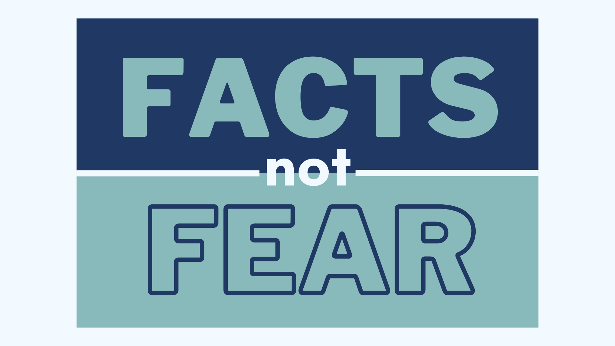

Slide 2
Here’s What You’ll Learn
The key concerns causing most people’s fear about their retirement plan – inflation and volatility
How the timing of your retirement could impact the success of your financial plan?
How can you protect your money (or at least some of it) with safe-money strategies designed for guaranteed lifetime income?

Slide 4
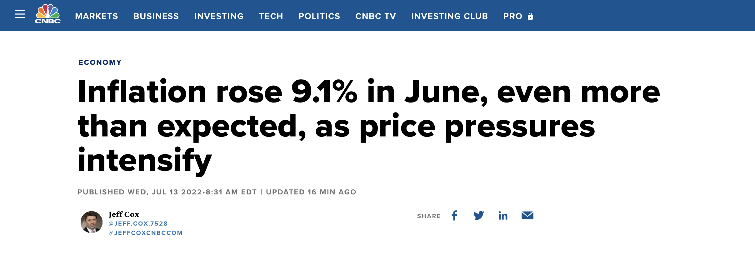
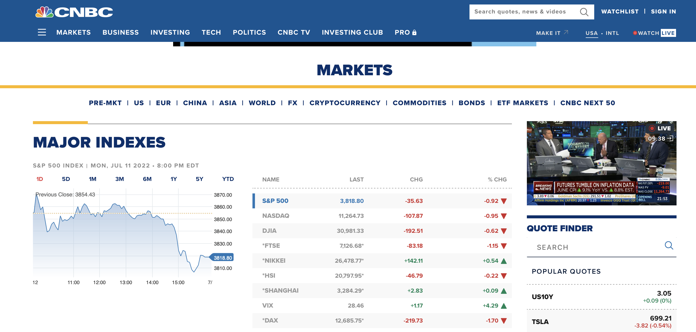
Inflation + Market Volatility

Slide 5
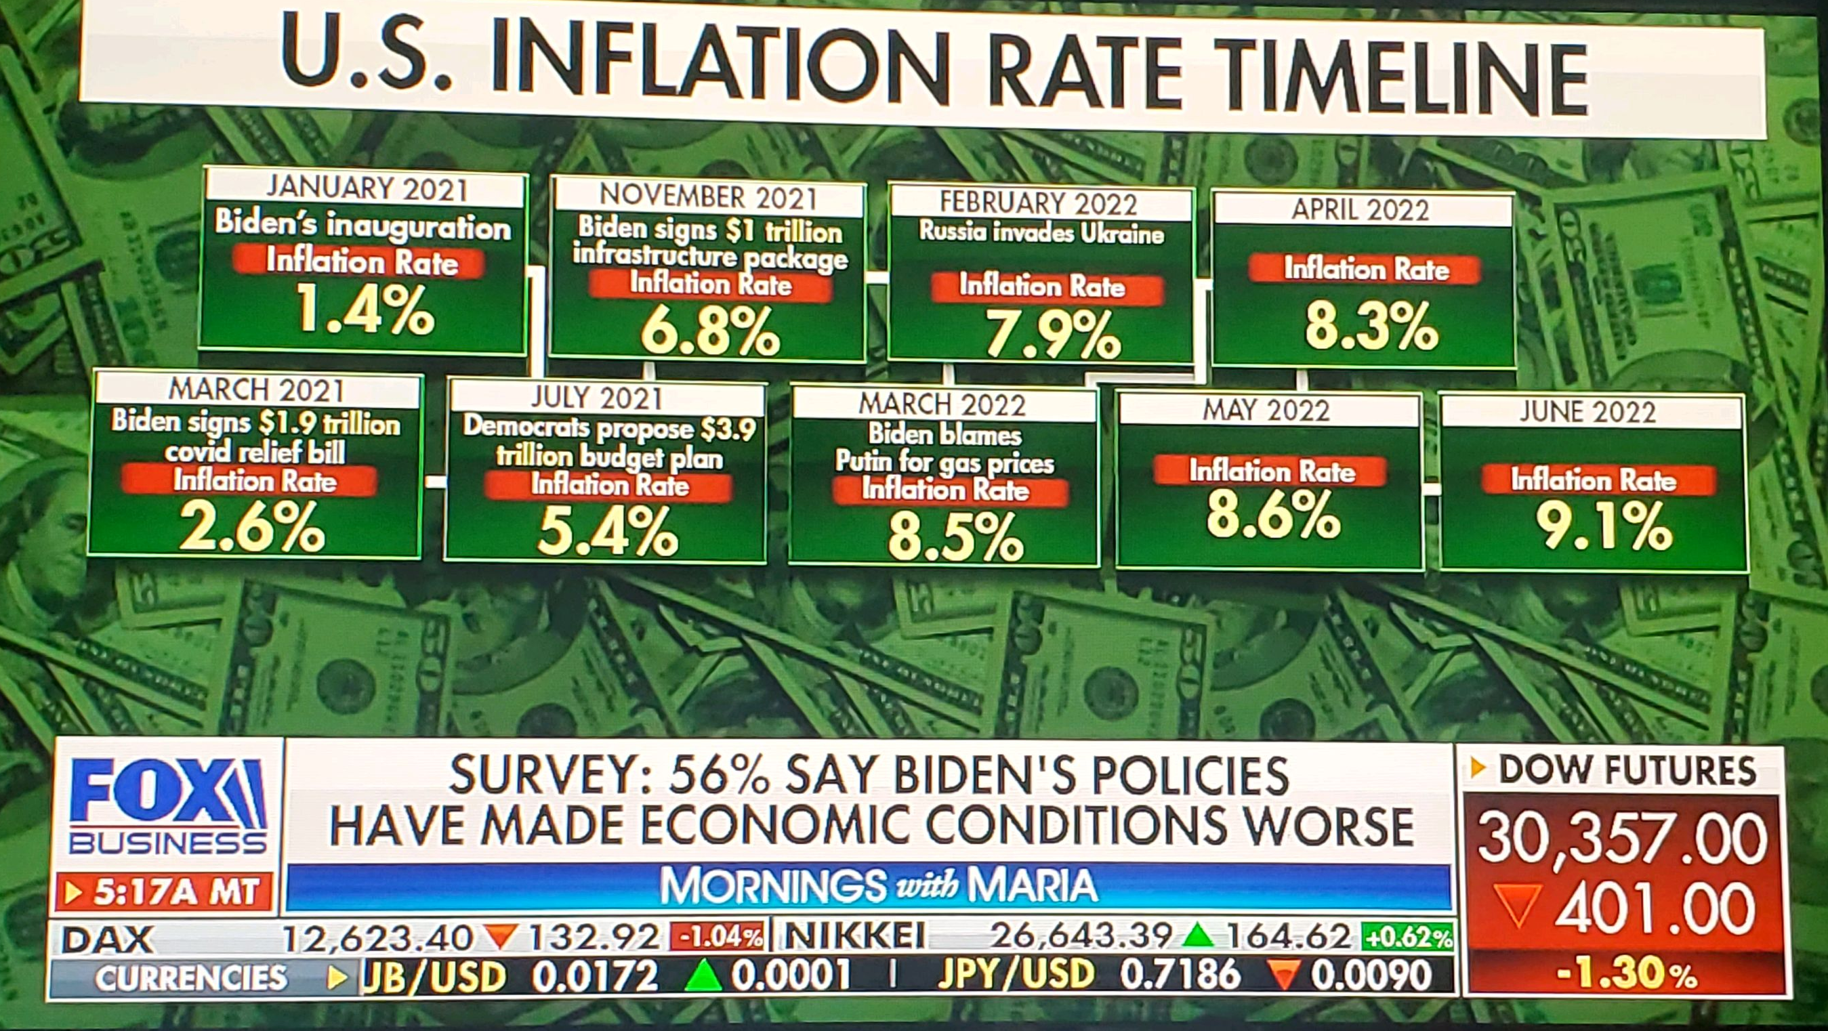
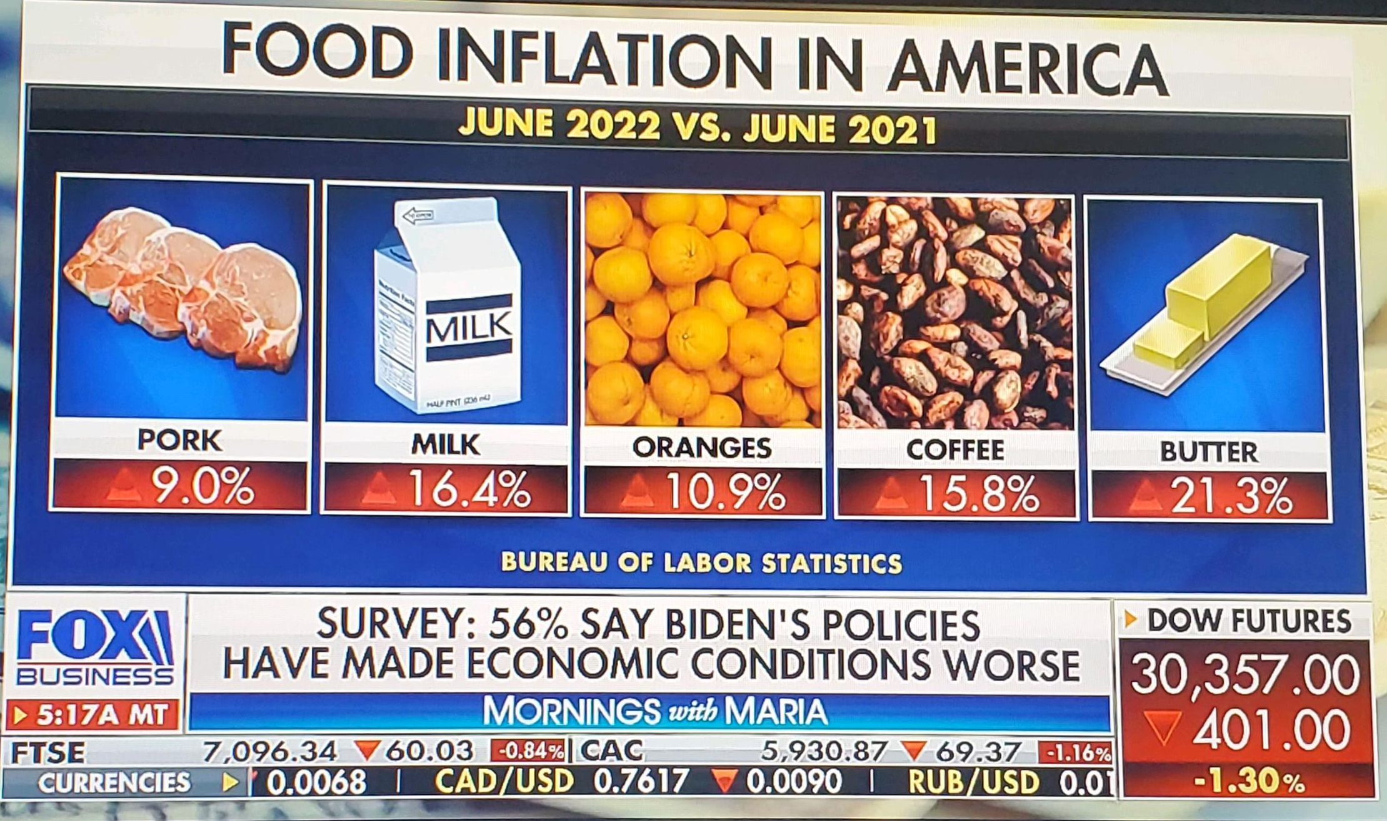
Inflation + Market Volatility

Slide 6
The Sequence of Returns Matters
“
Market losses in the first 5 years of retirement could shorten your portfolio by 15 years.”
Robert Pagliarini, “The Stunning Problem with the 4% Retirement Income Rule in One Chart,” Forbes, January 2020

Slide 7
What is Sequence of Returns?
John
Jane
Total Withdrawals
$1 Million
Total Withdrawals
$1,377,065
$1,147,066
Ending Account Balance
In retirement assets
Ending Account Balance
$2,111,556
$148,000
4% withdrawals
Adjusted 3% per year for inflation
Annual returns are based on the S&P 500 index. This is a hypothetical example for illustrative purposes only. The hypothetical returns are not indicative of actual market performance. Actual Market returns will vary. This is not intended to project the performance of any specific investment or index. If this were an actual product, the returns may be reduced by certain fees and expenses.

Slide 8
Asset Allocation and Diversification
A commonly-cited principle of asset allocation states that your portfolio should include a percentage of stocks equal to 100 minus your age.
As you get older, the likelihood of recovering from a market loss decreases.
Appropriately reallocating your assets can help avoid this retirement risk.

Slide 9
How do I protect against…
Inflation
Volatility
Timing

Slide 10
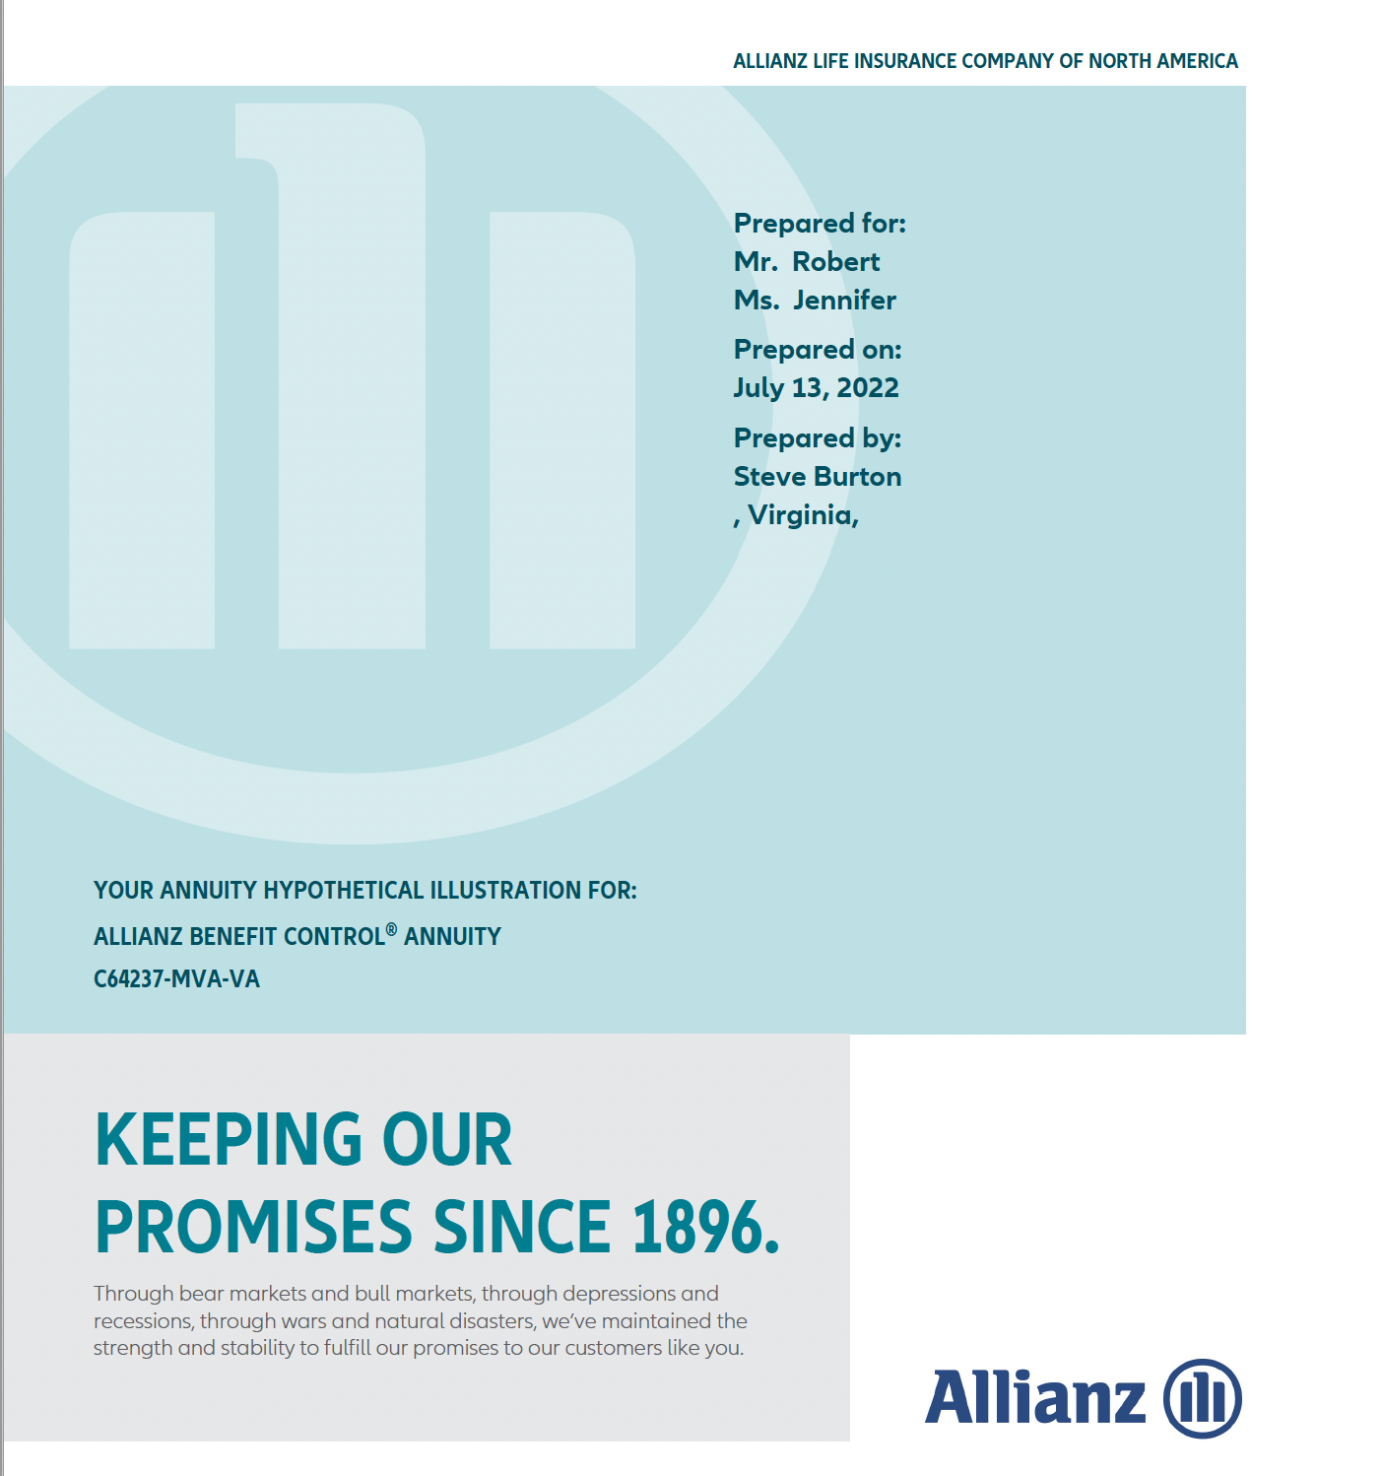
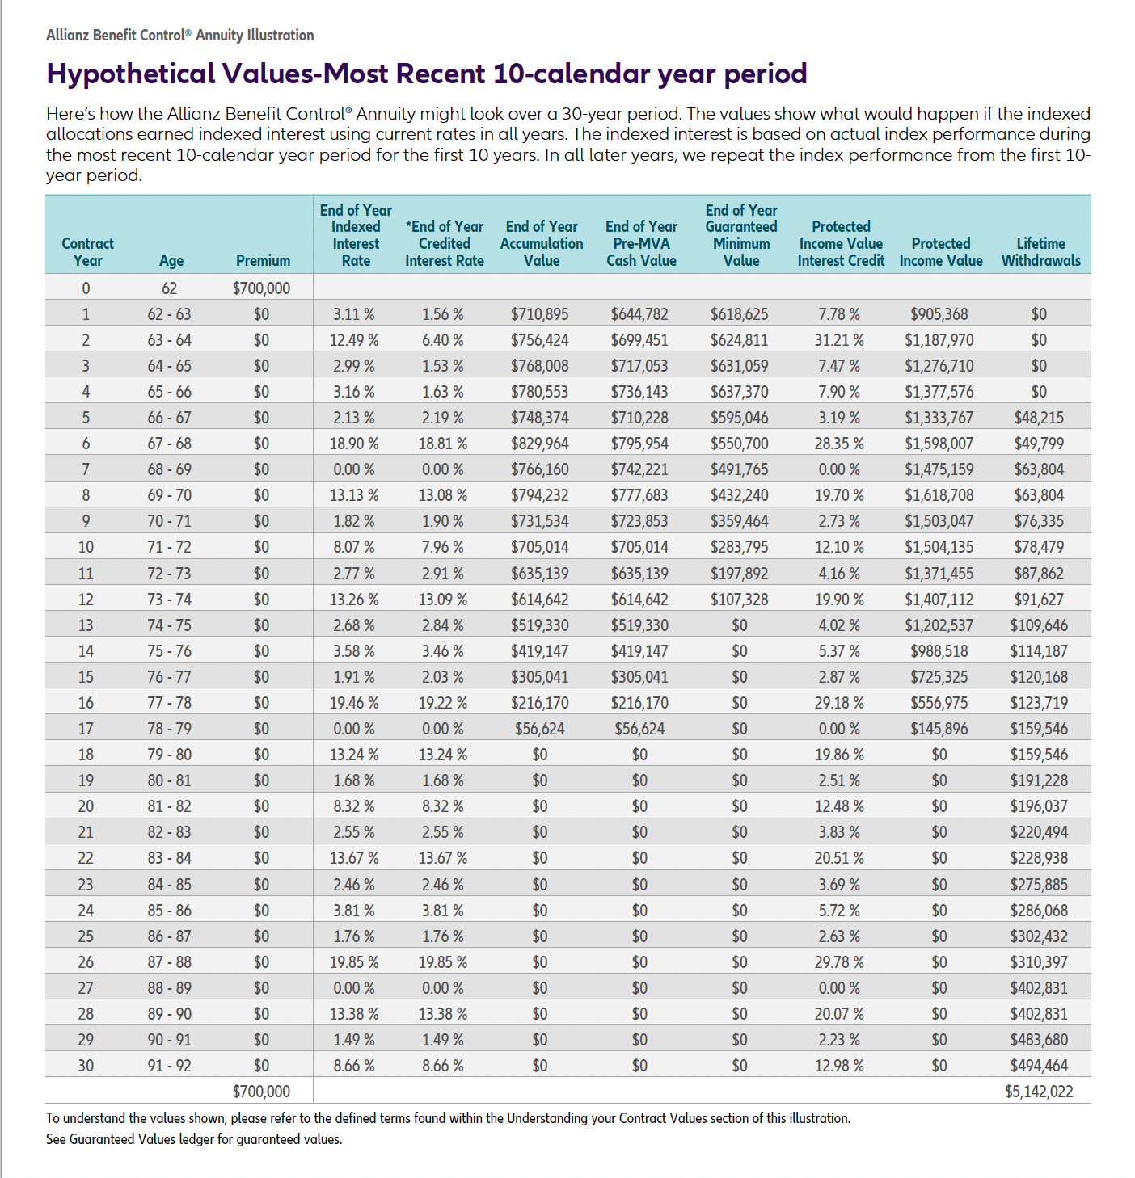

Slide 13
What’s the Right Plan for You?
1. Hover over the QR Code with your smartphone camera
2. Click the link to my online calendar
3. Select a time that works well for you – it’s FREE (seriously!)
QR CODE
For Online
Calendar

